Slide 1



Welcome
Wednesday 18th March
4.30-5.30
Welcome
Acknowledgment of Country
Our Support Team & Roles
  Class Teacher
  Deputy Principal (Student Services)
  School Psychologist
  School Chaplain
  School Principal
  Student Support Team and how we collaborate
How the School can Support Families
Common reasons families might seek support.
Understanding NCCD
What the Nationally Consistent Collection of Data is and how it informs school planning.
Levels of Support
  Tier 1, Tier 2 and Tier 3 support
  How support levels guide adjustments for students
Funding & Resources
How funding supports adjustments and additional supports.
How Support is Tracked
  Student monitoring and tracking processes
Further Information & Resources
Questions

Slide 2




Acknowledgement of Country
“We acknowledge past and present relationships the Whadjuk peoples have formed, and the care put into the beach, river and land we live on today. We recognise the traditions, culture and spirit of the Noongar nations, with respect. We thank the Whadjuk people for the land on which we play and learn, Richmond Primary School. Here is land, here is sky, here are my friends and here am I. We are on Whadjuk country.”
Written by year 5 students Luella, Vivienne and Lola 2023

Slide 3
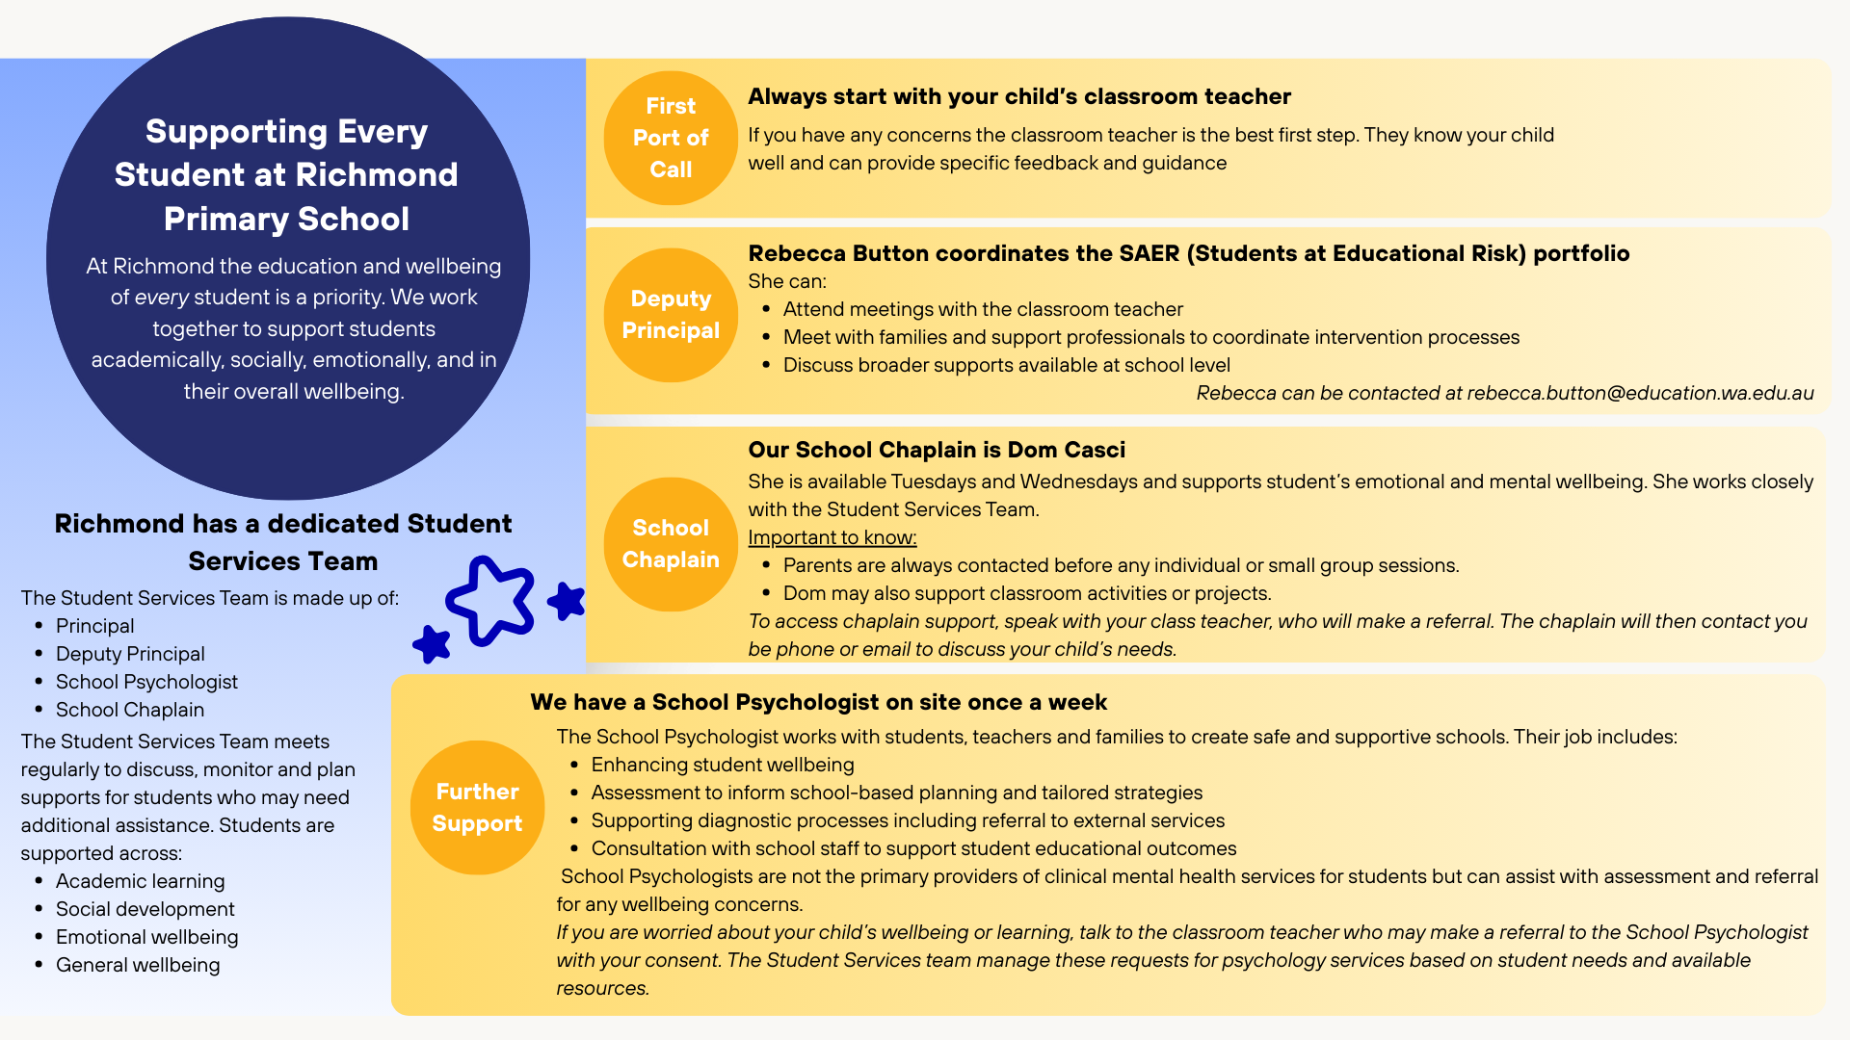

Slide 4


SCHOOL PSYCHOLOGY SERVICE
The School Psychology Service supports schools to optimise student educational outcomes.
Examples of Direct Services
(to support students)
Work in Indirect Services
(helping others support students)
Classroom observations to inform planning and intervention.
Completing psychometric assessments
Providing tailored recommendations and support to educators
Conducting interviews, and attending case conferences
Counselling (brief)- school based issues
Collaborating with Student Services team
Liaising with external providers
Providing Triple P training
Providing consultation support and psychoeducation
Support, research and recommend small group programs (such as Social Emotional Learning programs)
Notes:
SP’s are not the primary provider of intervention for clinical mental health difficulties.
Other areas we generally don’t cover- counselling for family based issues such as parental divorce, grief counselling, family therapy etc. Issues that are not school-based in nature.
If there is a better indicated service or intervention available externally, we will refer out in the first instance.
O

Slide 5
Accessing the School Psychologist
School-based referral system
Student Services triage and manage requests for psychology services based on student needs and available resources.
On site once a week (Tuesdays).
Requests for assistance by an external provider when the student is not already a shared client should be directed to the school (e.g., requests for educational or cognitive assessment).

Slide 6
School Psychology Service:
Informed Consent and Confidentiality
• Schools contact parent/ guardian prior to referral being made
• Parent/ guardian have the right to decline the School Psychology Services
• Parent/ guardian have the right to withdraw consent at any time
• Informed consent must be obtained by the School Psychologist, the school cannot obtain this on their behalf

Slide 7
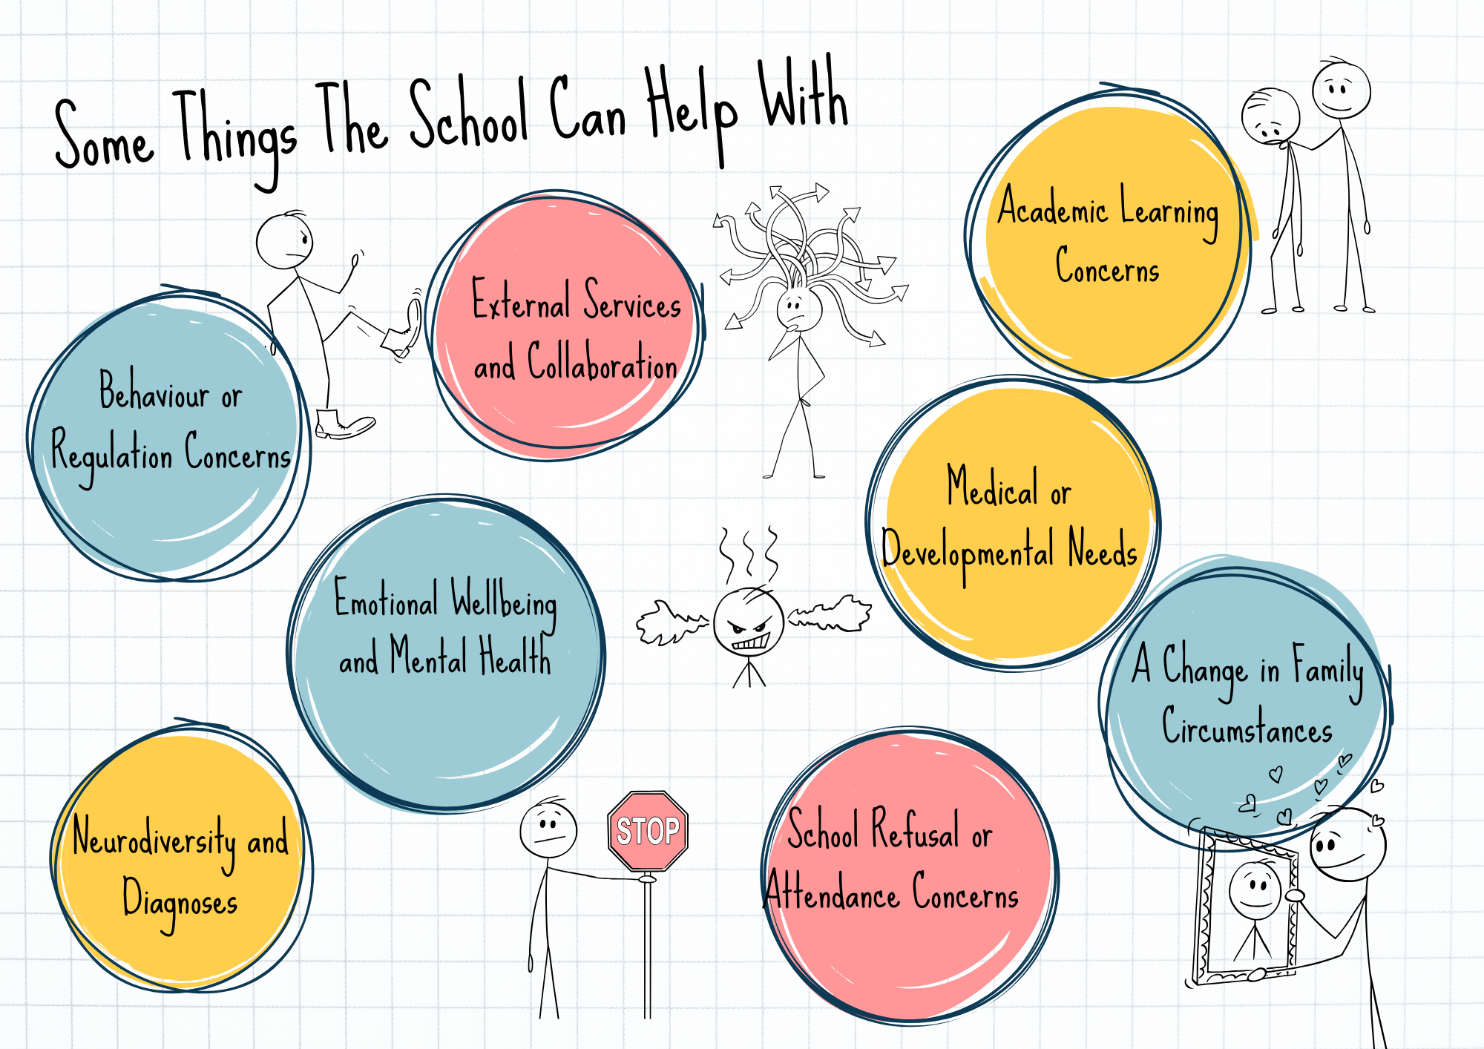

Slide 8
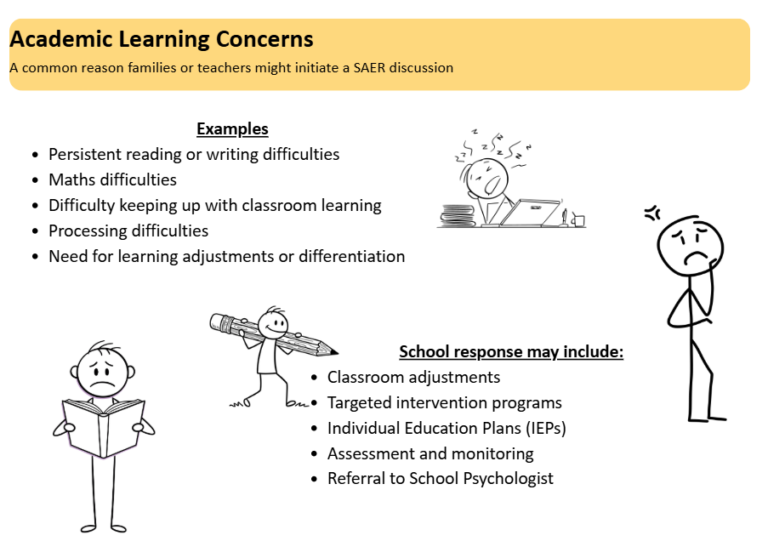

Slide 9
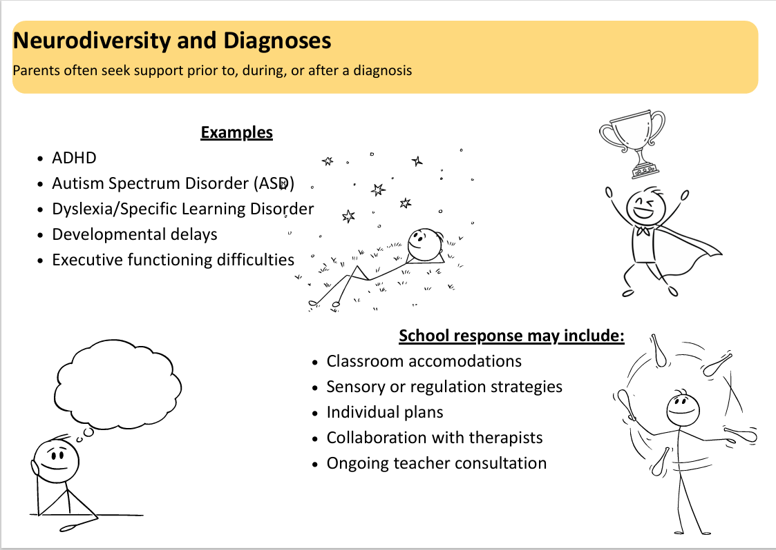

Slide 10
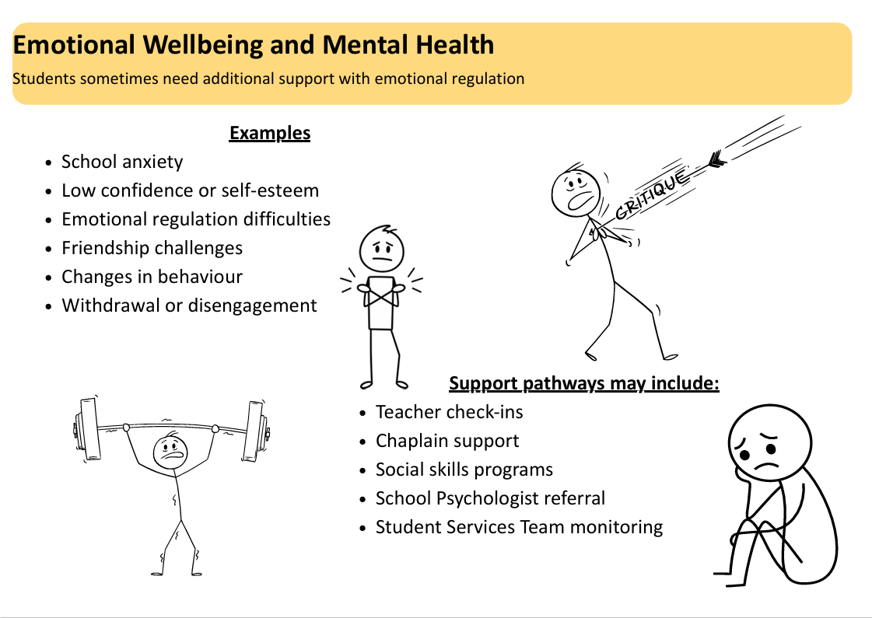

Slide 11
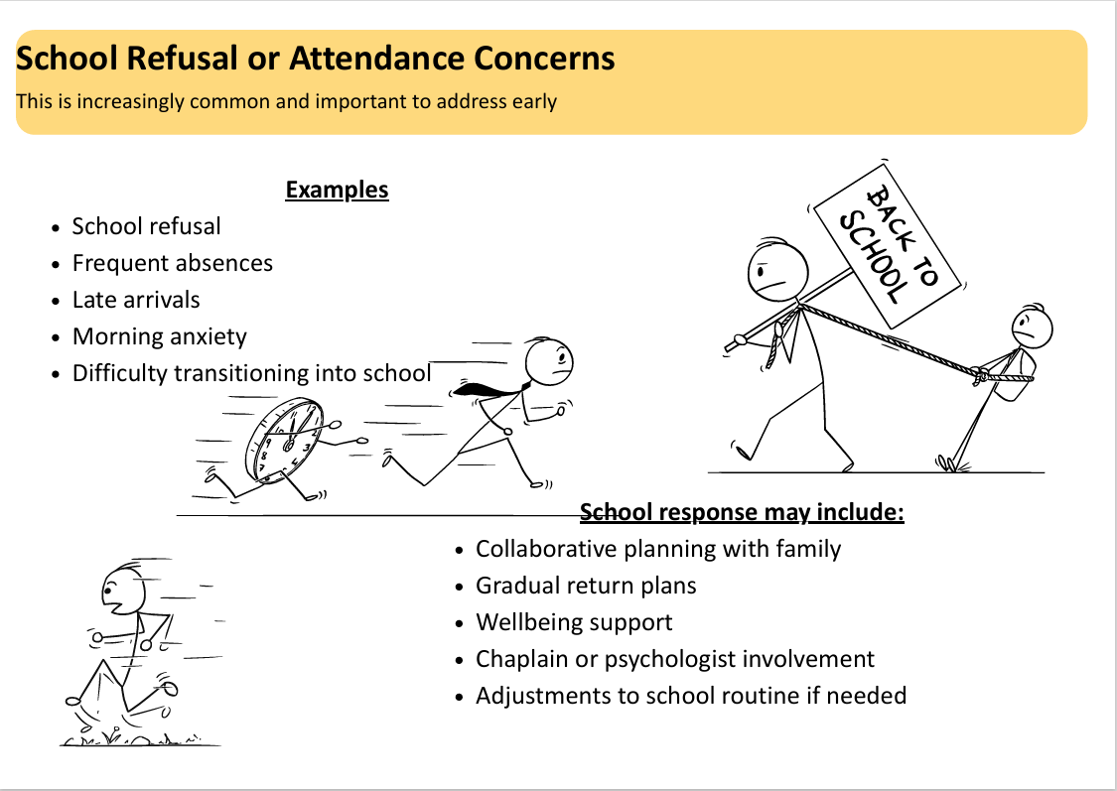

Slide 12
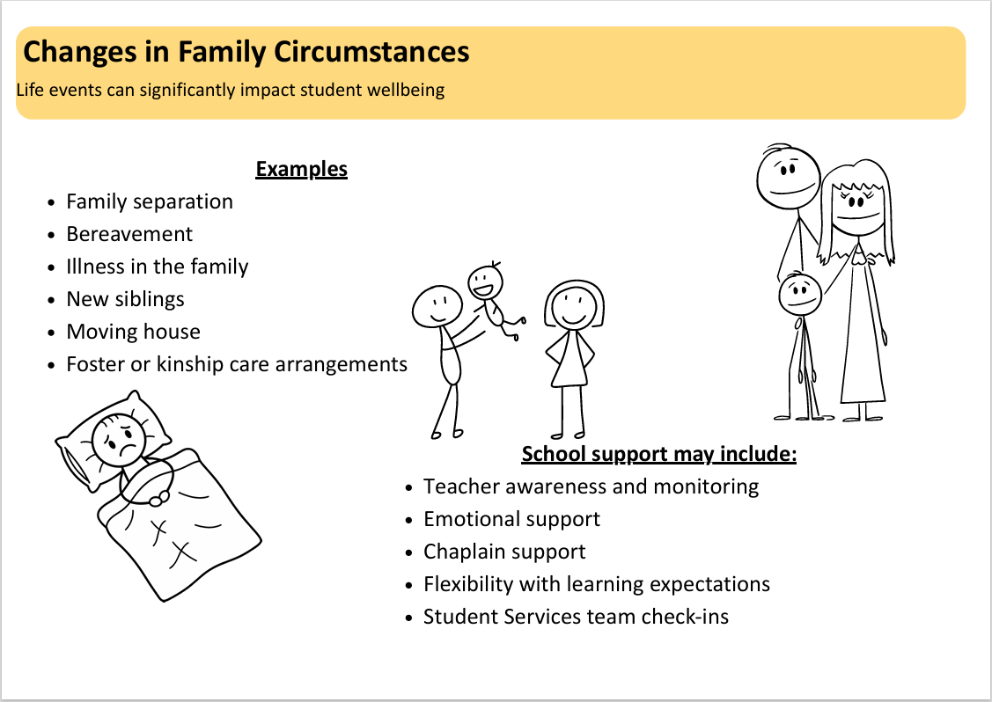

Slide 13
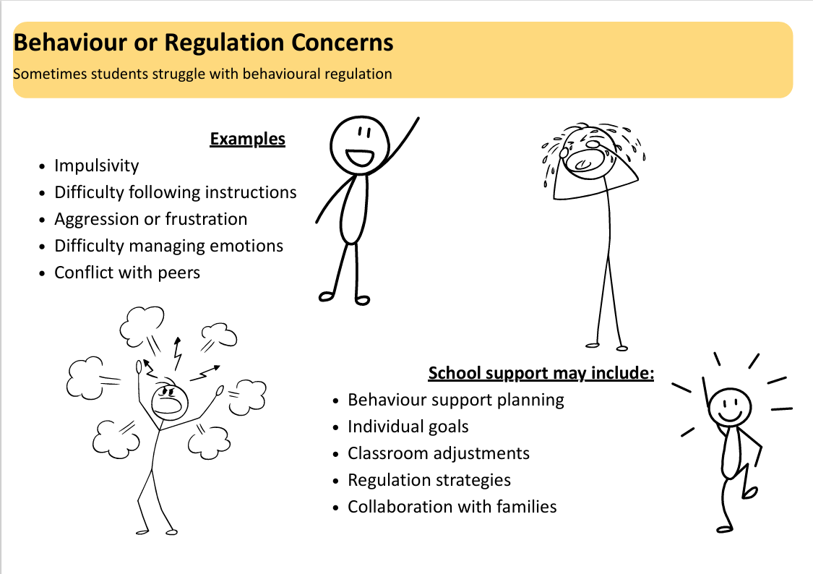

Slide 14
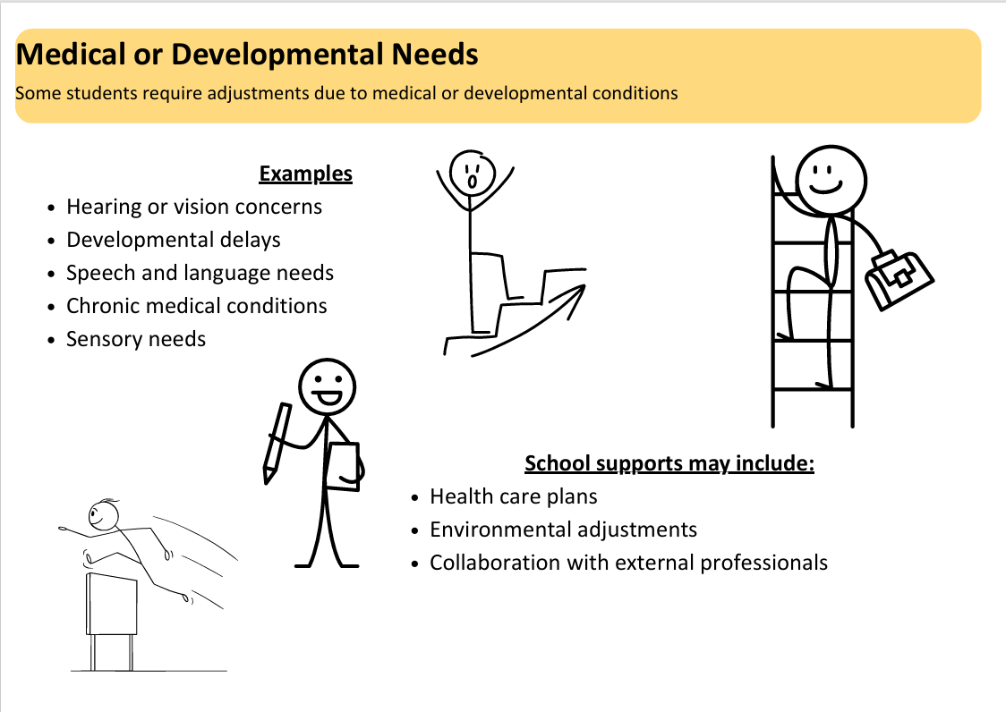

Slide 15
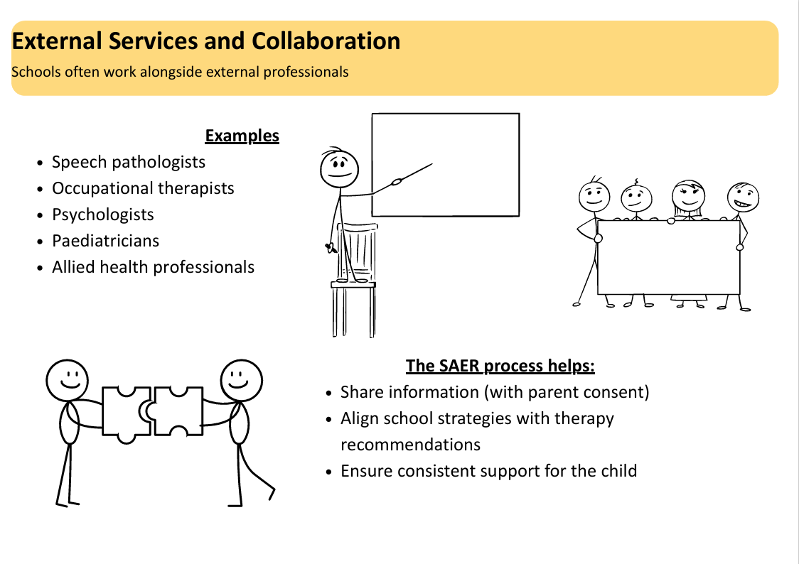

Slide 16

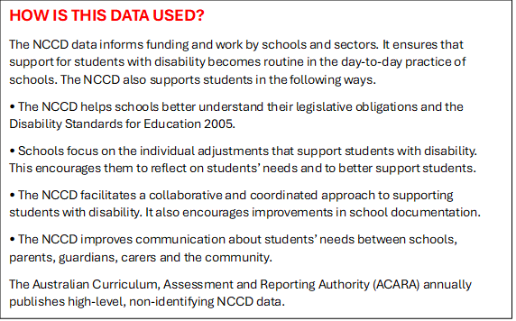
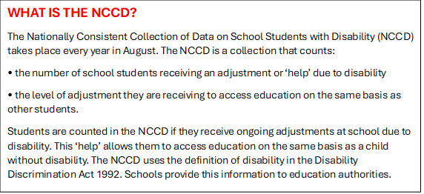
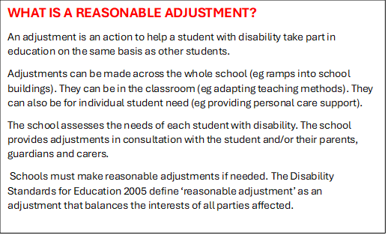

Slide 17
What are the Levels of Adjustments?
Adjustment Level | Examples
Quality differentiated teaching practice (QDTP) Students with disability are actively monitored and provided with adjustments that are not greater than those used to meet the needs of diverse learners. Adjustments are made infrequently as occasional action, or frequently as low level action such as monitoring. | Grouping students Provision of extra time Modification of tasks Multiples forms of instruction Provision of quiet areas
Supplementary adjustments Students with disability are provided with adjustments that are supplementary to the strategies and resources readily available to all students within the school. Adjustments occur for particular activities at specific times throughout the week. | Prearrangement of frequent breaks Adjustment of workload expectation Modification of teaching program Targeted individual prompting throughout day Alternative or practical tasks for assessment Colour coding of notes/materials/books Individualised desk goals and reminders
Substantial adjustments Students with disability who have more substantial support needs are provided with essential adjustments and considerable adult assistance. Adjustments to the usual educational program occur at most times on most days. | Meet regularly with student services to develop, plan, and implement curriculum. Daily communication with parents/carers. Significant adjustments made to environment Use support teacher/assistant to break down target skills into one or two stage instructions most of the time. An individualised program delivered individually or in very small group for most of the day.
Extensive adjustments Students with disability and very high support needs are provided with extensive targeted measures and sustained levels of intensive support. Adjustments to the regular educational programs occur at all times. | An individually delivered alternative curriculum. Individual/physical prompting, delivered one-to-one by an extra staff member, pervasively throughout the day? Alternative methods of communication eg: Auslan, Braille Highly individualised daily self-care strategies eg: toileting, hygiene, eating, dressing?

Slide 18
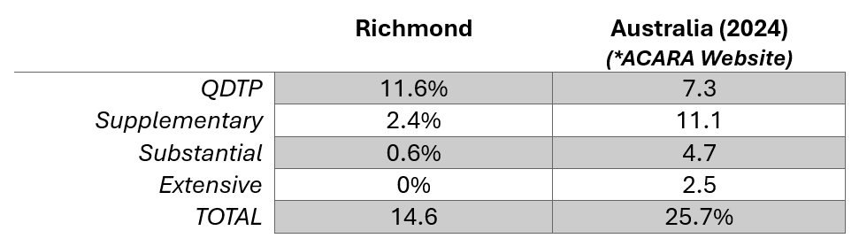
Percentage of Students with Educational Adjustments

Slide 19
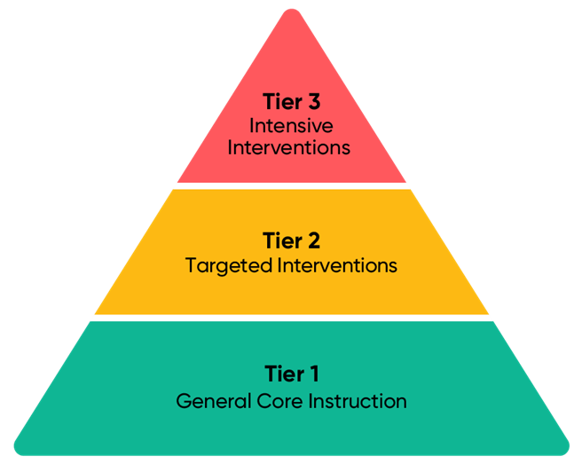
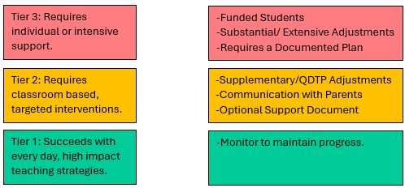
Levels of Support
1-5% of students
10-15% of students
80-90% of students

Slide 20
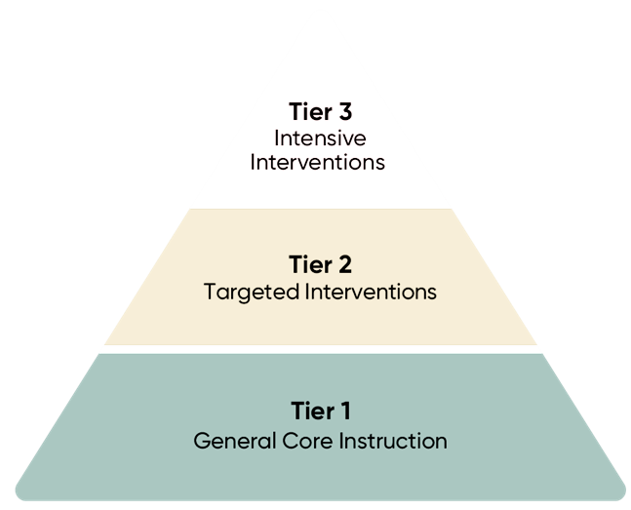
The Foundation: High Quality Core Instruction
Evidence based teaching informed by the science of learning through our partnership with Shaping Minds and the application of High Impact Teaching Strategies
Explicit literacy instruction including systematic synthetic phonics through UFLI Foundations and structured writing through Talk for Writing
Clear lesson structures with modelling, guided practice, and gradual release
Consistent routines and organised classroom environments that support focus and independence
Strong knowledge of each student’s strengths, needs, and interests
Collaboration between teachers, support staff, and the Student Services team

Slide 21
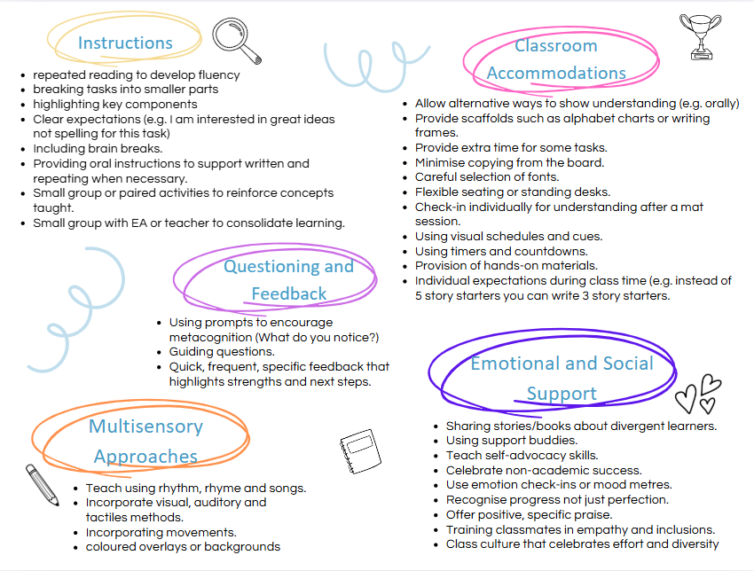
Targeted Support for Students
Approximately 14% of Richmond students benefit from Tier 2 support alongside the high quality classroom instruction provided to all students.
The strategies shown here are examples of the support structures teachers may use to provide additional targeted support.
Approaches may vary depending on the year level, learning area, teacher expertise and individual student needs.
Each situation is unique, and our teachers use their professional knowledge to select the most appropriate strategies to support student progress.

Slide 22
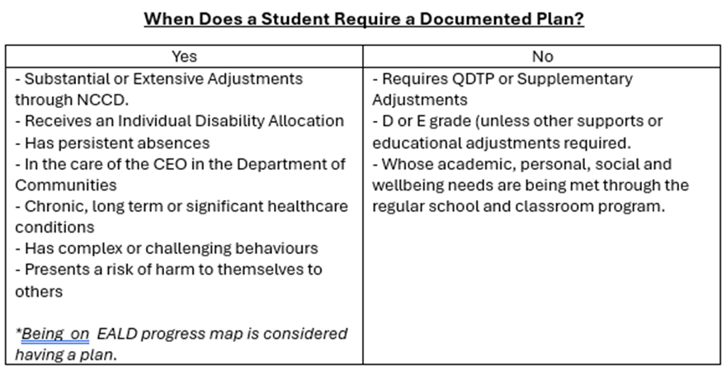
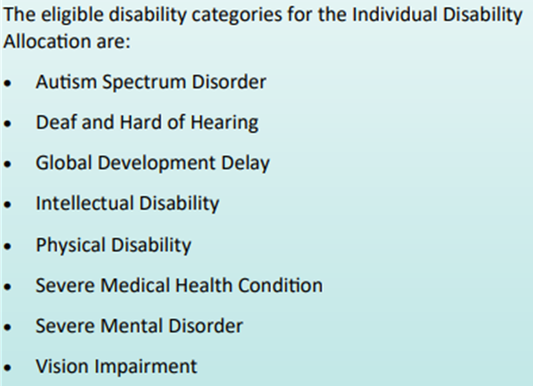
Tier 3 Support
Tier 3 students require substantial additional support and receive Individual Disability Allocation funding. These students require a documented plan to guide the adjustments and supports provided.
At Richmond Primary School, Tier 3 students are funded at varying levels depending on their individual needs. Currently, our students who receive funding are all classified as requiring substantial adjustments. We have no students with extensive adjustments.
Extensive adjustments involve highly individualised and comprehensive teaching and learning supports, including constant and highly structured adult assistance across most aspects of the school program.
Students receiving Individual Disability Allocation are supported through personalised planning, targeted strategies and collaboration between teachers, support staff and the Student Services team.

Slide 23
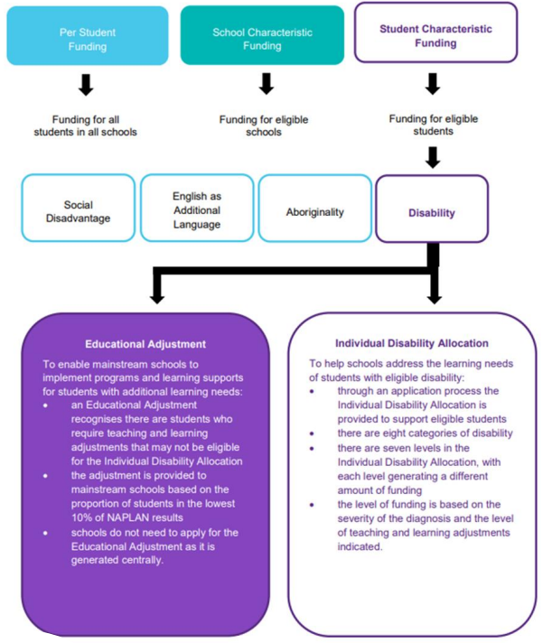
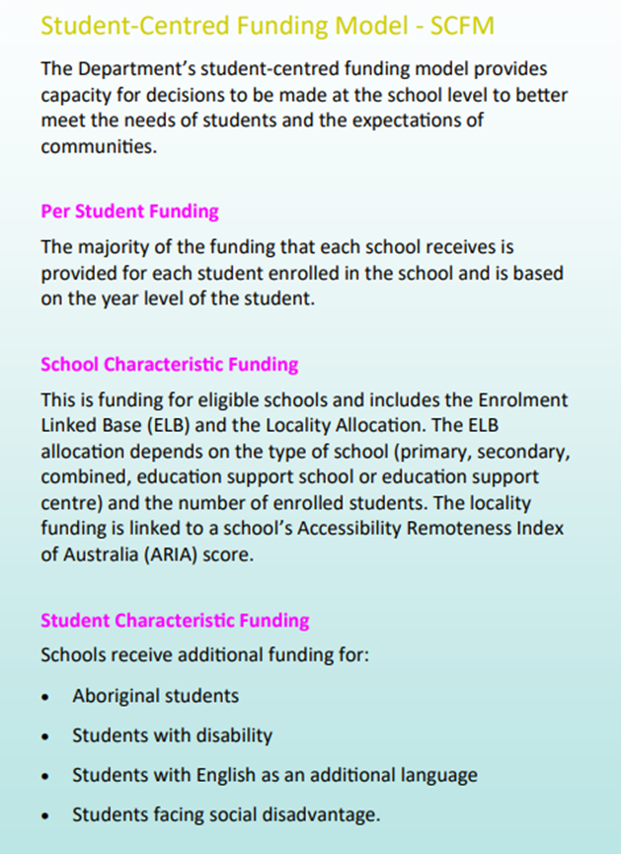
STUDENT CENTRED FUNDING MODEL
Graphics created by Millen PS

Slide 24
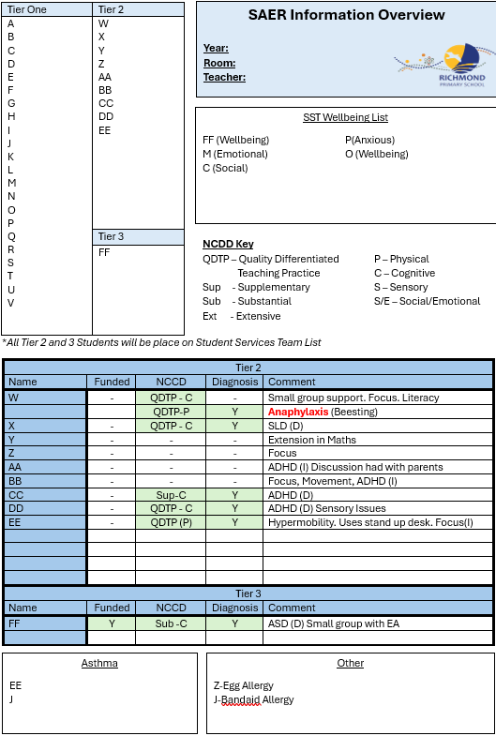
Tracking Student Information
The deputy maintains an Information Overview Sheet in Office that provides a snapshot of important student information. This document is regularly updated as teachers and families share relevant updates.
Twice each year, staff are given dedicated time during staff meetings to review, audit and update the information to ensure it remains accurate.
At the end of the year, teachers participate in a handover process where the updated Information Overview Sheet is discussed with the following year’s teacher to support continuity of care and learning.

Slide 25
Learning, Development and Neurodiversity
General Parenting and Child Development
Raising Children Network - Evidence based information about child development, behaviour, health and learning from birth to adolescence.
raisingchildren.net.au
Ngala Parenting Line (WA) - Free parenting advice and support for families across Western Australia. Phone 9368 9368 or 1800 111 546
ngala.com.au
Perth Kids Hub - Directory of local therapists, educational services and specialists in Perth.
perthkidshub.com.au
Literacy and Learning Difficulties
DSF Literacy and Clinical Services (Perth) -Specialists in dyslexia, reading difficulties and evidence based literacy intervention.
dsf.net.au
SPELD WA - Support, information and advocacy for children with specific learning difficulties such as dyslexia.
speld.org.au
Autism
Autism Association of Western Australia - Family support, therapy services and information for autistic children and their families.
autism.org.au
Developmental Disability WA - Autism Parents Handbook outlining services available across Western Australia.
ddwa.org.au
Language Delay and Speech Development
Speech Pathology Australia - Information about speech and language development and how to find a speech pathologist.
speechpathologyaustralia.org.au
Child Development Service (WA Health) - Assessment and support for children with developmental delays.
cahs.health.wa.gov.au
ADHD
ADHD WA - Parent education programs, resources and peer support groups.
adhdwa.org
Child and Adolescent Health Service ADHD programs - Information sessions and resources for families.
cahs.health.wa.gov.au
Gifted and Twice Exceptional Learners
Gifted and Talented Children’s Association of WA - Support and resources for families of gifted learners.
gtcawa.org.au

Slide 26
Depression and Youth Mental Health
Headspace Fremantle – mental health support for young people and families.
headspace.org.au
Youth Focus – WA organisation supporting youth mental health. .
youthfocus.com.au
School Refusal and Attendance Concerns
ReachOut Parents – guidance for supporting school avoidance
parents.au.reachout.com
Beyond Blue – Information and support for anxiety and depression.
beyondblue.org.au
Wellbeing, Mental Health, and Family Support
Grief and Bereavement
Australian Centre for Grief and Bereavement - resources and support for families experiencing loss.
grief.org.au
Red Nose Grief and Loss Support - support for families experiencing the death of a child or loved one
rednosegriefandloss.org.au
Griefline – phone support and resources for grief and loss.
griefline.org.au
Anxiety and Emotional Wellbeing
Beyond Blue – Information and support for anxiety and depression.
beyondblue.org.au
ReachOut Parents – Practical advice for supporting young people with emotional wellbeing and mental health.
parents.au.reachout.com
Kids Helpline – free counselling for young people aged 5-25. Phone 1800 55 1800
kidshelpline.com.au
Friendship, Bullying and Online Safety
ESafety Commissioner – advice for families on cyber safety and online behaviour
esafety.gov.au
Kids Helpline – Resources for friendship, bullying, and social issues.
kidshelpline.com.au
Occupational Therapy and Sensory Needs
Occupational Therapy Australia - information about sensory processing and finding occupational therapists
otaus.com.au
Child and Adolescent Health Service ADHD programs - Information sessions and resources for families.
cahs.health.wa.gov.au
Medical and health concerns
Healthdirect Australia - 24 hour free health advice line. Phone 1800 022 222
healthdirect.gov.au
Child and Adolescent Health Service – health information and specialist services for children
cahs.health.wa.gov.au
Behaviour, Sleep and Everyday Parenting
Raising Children Network - Advice on behaviour, sleep and routines.
raisingchildren.net.au
Ngala – parenting support including sleep and behaviour issues.
ngala.com.au

Slide 27

Question Time

Slide 28
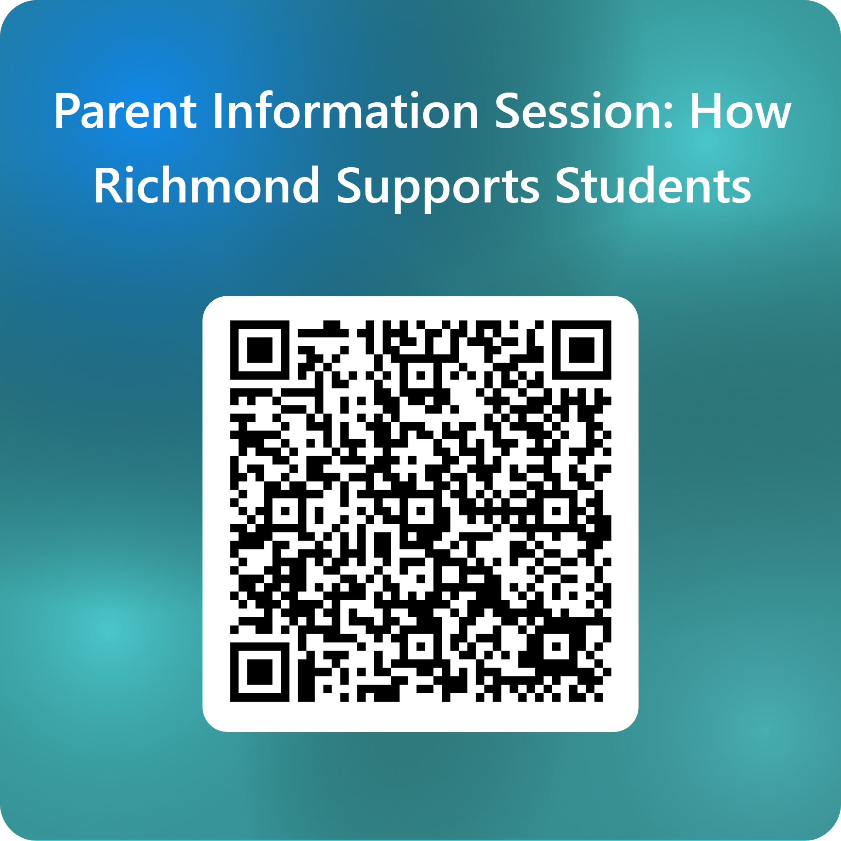
Feedback: Please Use the QR Code below to provide us with feedback.

